Slide 1
Internship studio
Ethical Hacking Internship
Created by Soumyadip halder

Slide 2
Vulnerability Report – Task 3
Report ID: #Task3-XSS-Intruder
Vulnerability: Reflected Cross-site Scripting (XSS)
Target URL: http://testasp.vulnweb.com/search.asp
Affected Parameter: searchFor
Severity: Medium
Description:
The searchFor parameter is vulnerable to reflected XSS. Payloads passed through this parameter are rendered without sanitization, leading to execution of arbitrary JavaScript.

Slide 3
Steps to Reproduce:
Visit http://testasp.vulnweb.com/
Click on the "Search" tab.
Intercept the search request using Burp Suite Proxy.
Send the intercepted request to Intruder.
Add payloads in Intruder like:
<script>alert(1)</script>
<img src=x onerror=alert(1)>
"><svg/onload=alert(1)>
Launch attack and check responses.
Observe successful JavaScript execution in the browser.
Impact:
Allows attackers to inject and execute arbitrary JavaScript.
Could steal cookies, session tokens, or perform phishing/redirection.
Can be used to pivot toward more dangerous attacks (e.g., session hijacking).
Mitigation:
Use output encoding to properly sanitize reflected content.
Implement Content Security Policy (CSP) headers.
Validate and filter all input on both client and server side.
Use security libraries like DOMPurify to clean HTML.

Slide 4
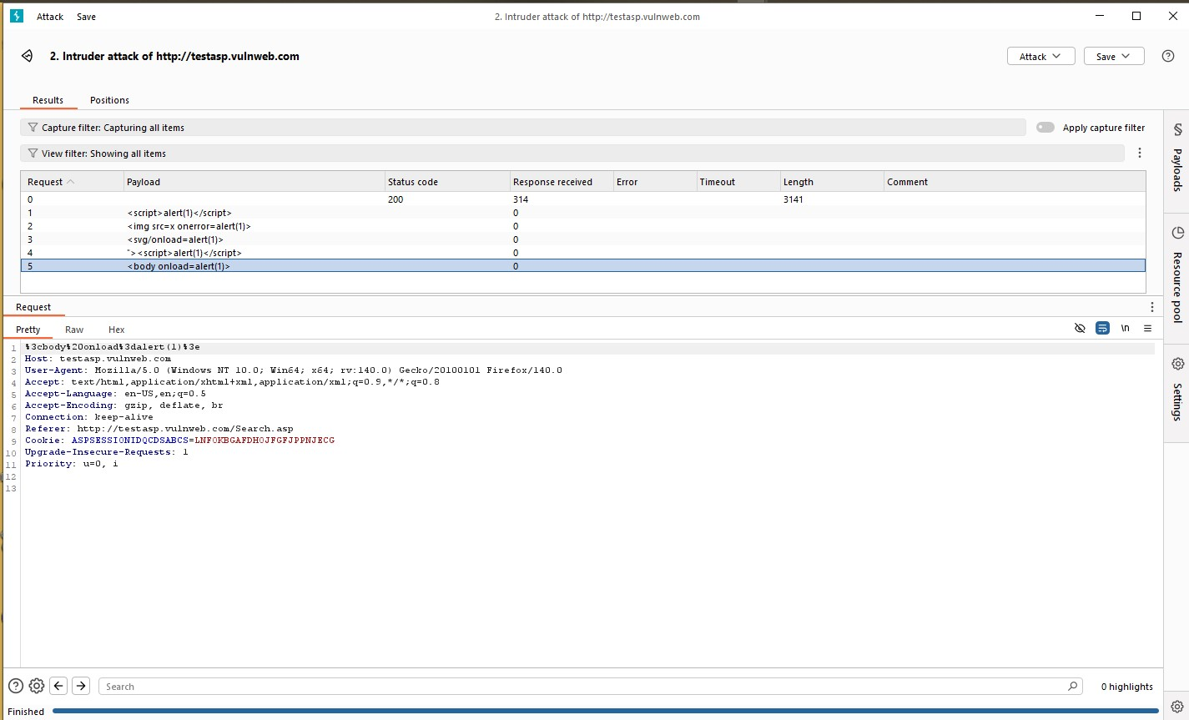

Slide 5
